Slide 1







3140702
Operating System
Unit – 5 Deadlock
Subject Faculty: Prof. Suhag Baldaniya

Slide 2
Disclaimer
It is hereby declared that the production of the said content is meant for non-commercial, scholastic and research purposes only.
We admit that some of the content or the images provided in this channel's videos may be obtained through the routine Google image searches and few of them may be under copyright protection. Such usage is completely inadvertent.
It is quite possible that we overlooked to give full scholarly credit to the Copyright Owners. We believe that the non-commercial, only-for- educational use of the material may allow the video in question fall under fair use of such content. However we honor the copyright holder's rights and the video shall be deleted from our channel in case of any such claim received by us or reported to us.

Slide 3
Topics to be covered
Deadlock and its Principles
Four Necessary Conditions of Deadlock
Deadlock Prevention
Resource Allocation Graph (RAG)
Deadlock Avoidance - Banker’s algorithm
Deadlock Detection & Recovery.

Slide 4
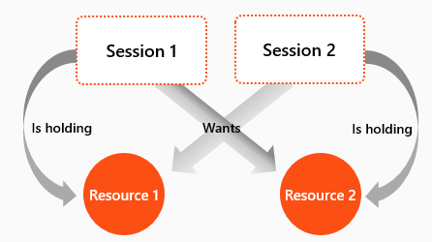
What is Deadlock?

Slide 5
Definition of Deadlock
A deadlock consists of a set of blocked processes, each holding a resource and waiting to acquire a resource held by another process in the set.
For Example:
two processes each want to record a scanned document on a CD.
process 1 requests for scanner & gets it
process 2 requests for CD writer & gets it
process 1 requests CD writer but is blocked
process 2 requests scanner but is blocked.
At this point both processes are blocked and will remain so forever,
This situation is called a deadlock

Slide 6
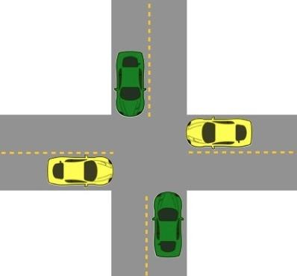
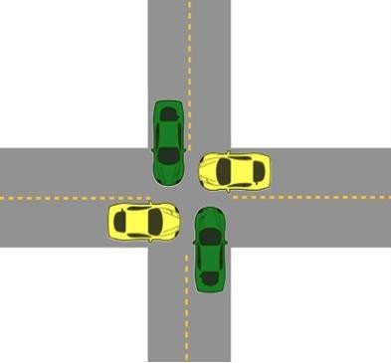
Deadlock
The processes are the cars.
The resources are the spaces occupied by the cars
Deadlock possible
Deadlock occurred

Slide 7
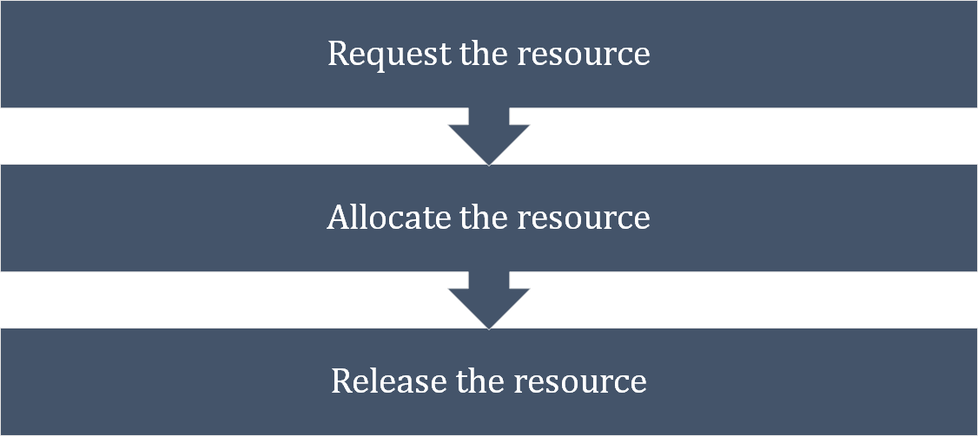
Sequence of events to use a Resource

Slide 8
Necessary Conditions for Deadlock
Mutual exclusion:
At least one resource type in the system which can be used in
non-shareable mode (i.e. one at a time). for example printer.
Because many resource can be shared by more than one process at a time .(e.g., Memory location).
Hold and Wait:
Processes are allowed to request for new resources without releasing the resources they are currently holding.
Hold and wait is a condition in which a process is holding one resource while simultaneously waiting for another resource that is being held by another process.

Slide 9
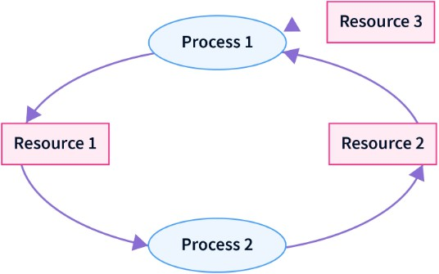
Necessary Conditions for Deadlock
The process cannot continue till it gets all the resources.
required
Resource 1 is allocated to Process 2
Resource 2 is allocated to Process 1
Resource 3 is allocated to Process 1
Process 1 is waiting for Resource 1 and holding Resource 2 and Resource 3
Process 2 is waiting for Resource 2 and
holding Resource 1

Slide 10
Necessary Conditions for Deadlock
No pre-emption:
A resource can be released only voluntarily by the process holding it after that process has completed its task.
Preemption is temporarily interrupting an executing task and later resuming it.
For example, if a process P1 is using a resource and a high priority process P2 requests for the resource, process P1 is stopped and the resources are allocated to P2.

Slide 11
Necessary Conditions for Deadlock
Circular wait:
Two or more processes must form a circular chain in which each process is waiting for a resource that is held by the next member of the chain.
In circular wait, two or more processes wait for resources in a circular order.

Slide 12
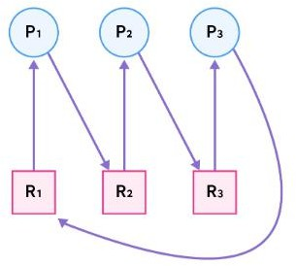
Necessary Conditions for Deadlock
To eliminate circular wait, we assign a priority to each resource.
A process can only request resources in
increasing order of priority.
In the example above, process P3 is
a
requesting resource R1, which has
number lower than resource R3 which is
already allocated to process P3.
So this request is invalid and cannot be made, as R1 is already allocated to process P1.

Slide 13
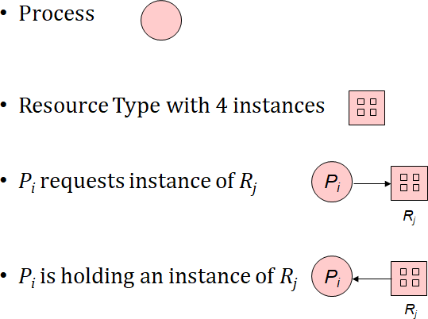
Deadlock Modeling
For Deadlock modeling a directed graph,
Allocation Graph (RAG) is used.
Notation used for representation of RAG -
called
Resource

Slide 14
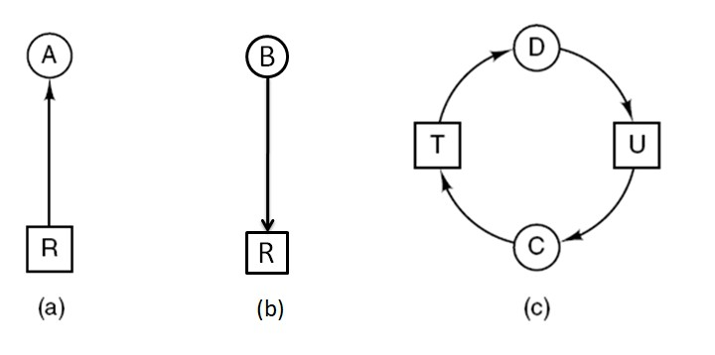

Construction of Resource Allocation Graph
B
R
(b)
Figure : Resource allocation graphs
(a) Holding a resource. (b) Requesting a resource. (c) Deadlock.

Slide 15
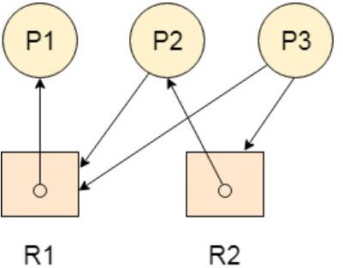
Resource Allocation Graph
Problem-1 : Find the system is in a deadlock state or not?

Slide 16
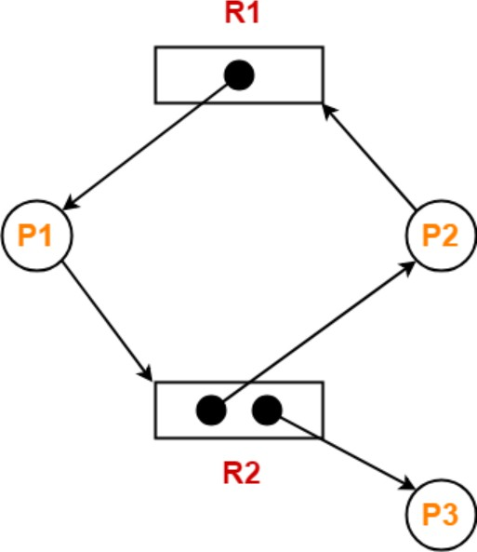
Resource Allocation Graph
Problem-2 : Find the system is in a deadlock state or not?

Slide 17
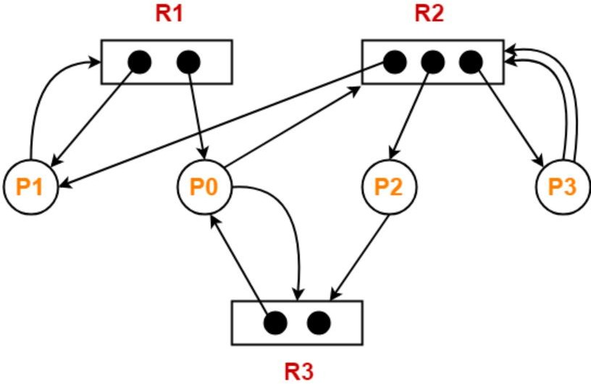
Resource Allocation Graph
Problem-3 : Find the system is in a deadlock state or not?

Slide 18
Handling Deadlocks In DOS
Handling of deadlocks in distributed systems is more complex than in centralized systems.
Because the resources, the processes, and other relevant
information are scattered on different nodes of the system.
Strategies to handle deadlocks:
Prevention – constraints are imposed on the way in which
processes request resources in order to prevent deadlocks.
Avoidance – resources are carefully allocated to avoid deadlocks.
Detection and recovery – deadlocks are allowed to occur and a detection algorithm is used to detect them. After deadlock is detected it is resolved by certain means.
Ignore – do nothing, just ignore the problem.

Slide 19
Deadlock Prevention
Deadlock can be prevented by violating the one of the four conditions that leads to deadlock.
Attacking the Mutual Exclusion Condition
Attacking the Hold and Wait Condition
Attacking the No Preemption Condition
Attacking the Circular Wait Condition

Slide 20
Violation of Mutual Exclusion Condition
No deadlock if each resource can be assigned to more than one process.
This can violate the hardware properties of a resource.
We can not assign some resources to more than one process at a time such as printer.
Not feasible

Slide 21
Violation of Hold and Wait Condition
Conservative Approach : Process is allowed to start execution if and only if it has acquired all the resources (less efficient, not implementable, easy, deadlock independence)
A process is allowed to run if all resources it needed is available.
Otherwise nothing will be allocated and it will just wait.
Problem with this strategy is that a process may not know
required resources at start of run.
Resource will not be used optimally.
It may cause starvation of a process that needs may resources.

Slide 22
Violation of Hold and Wait Condition
Do not Hold: A process will acquire all desired resources but before making any fresh request it must release all the resources that it currently hold (efficient, implementable)
Wait Timeout: We place a maximum time up to which a process can wait after which process and release all the holding resources.

Slide 23
Violation of No Preemption Condition
Forcefully Pre-emption: We allow a process to forcefully pre-empt the resource by other processes
For example - When a process request for a resource that is currently not available, all the resources held by the process are taken away from it and process is blocked.
This method may be used by high priority process or system
process.
The process which are in waiting state must be selected as a victim instead of process in the running state.

Slide 24
Violation of Circular Wait Condition
To provide a global numbering of all the resources.
Processes can request resources whenever they want to, but all requests must be made in increasing or decreasing order.
A process need not acquire them all at once.
Circular wait is prevented if a process holding resource n cannot wait for resource m, if m > n.
1.Printer, 2.Scanner, 3.Plotter, 4.Tape drive, 5.CD ROM
A process may request 1st a CD ROM drive, then tape drive. But it may not request 1st a plotter, then a Tape drive.
Resource graph can never have cycle.
P1 – R1, R2, R4, R43, R56
P1 – R1, R4, R2 NOT POSSIBLE

Slide 25
Deadlock Avoidance
In most systems, however, resources are requested one at a time. The system must be able to decide whether granting a resource is safe or not and only make the allocation when it is safe.
Safe and Unsafe state
If the system can allocate resources to the process in such a way that it can avoid deadlock. Then the system is in a safe state.
If the system can’t allocate resources to the process safely, then the system is in an unsafe state.

Slide 26
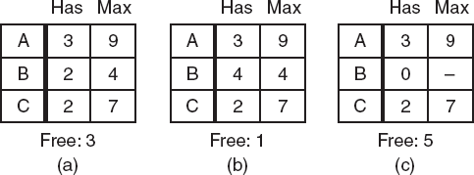
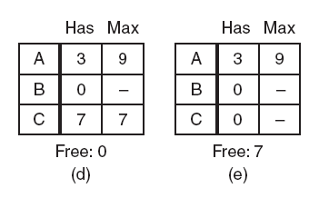
Safe State
A total of 10 instance of the resource exist, so with 7 resources already allocated, there are 3 still free.
Figure : Demonstration that the state in (a) is safe.

Slide 27
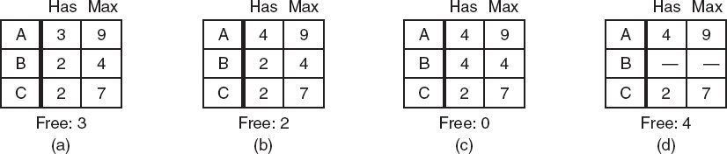
Unsafe State
Figure : Demonstration that the state in (b) is not safe.
Thus from the safe state system can guarantee that all process will
finish and from unsafe state no such guarantee can be given.

Slide 28






The Banker’s Algorithm for a Single Resource
It is modeled on the way a small-town banker might deal with a group of customers to whom he has granted lines of credit.
What the algorithm does is check to see if granting the request leads to an unsafe state.
If it does, the request is denied.
If granting the request leads to a safe state, it is carried out.

Slide 29
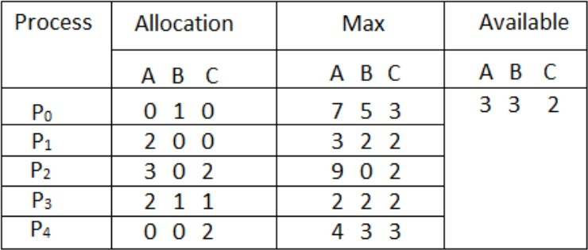
Numerical - The Banker’s Algorithm
Considering a system with five processes P0 through P4 and three resources of type A, B, C. Resource type A has 10 instances, B has 5 instances and type C has 7 instances. Find the safe sequence of the system with current allocation.

Slide 30
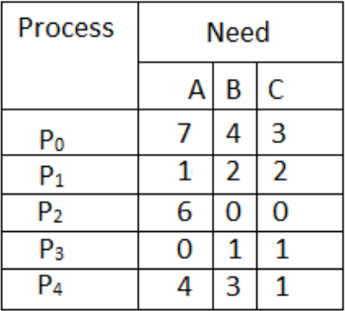

Slide 31
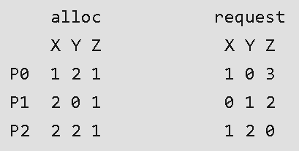
Numerical - The Banker’s Algorithm
A single processor system has three resource types X, Y and Z, which are shared by three processes. There are 5 units of each resource type. Consider the following scenario, where the column alloc denotes the number of units of each resource type allocated to each process, and the column request denotes the number of units of each resource type requested by a process in order to complete execution. Which of these processes will finish LAST? (GATE-2007 | 2- MARKS)
P0
P1
P2
None of the above, since
the system is in a deadlock

Slide 32
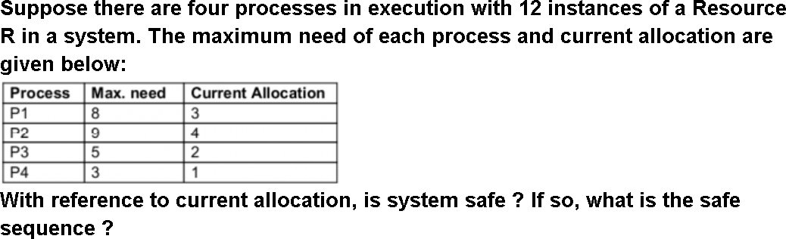
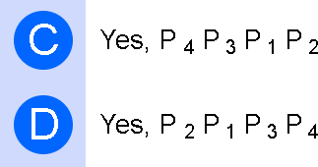
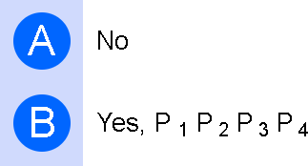
Numerical - The Banker’s Algorithm
(UGC-NET 2016 AUG)

Slide 33
Deadlock Detection
Deadlock detection and recovery is the process of detecting and resolving deadlocks in an operating system.
When deadlock occurs ?
Difference between prevention and detection ?
Instead, it lets them occur, tries to detect when this happens, and then takes some action to recover after the fact.
For deadlock detection, the system must provide
An algorithm that examines the state of the system to detect
whether a deadlock has occurred
And an algorithm to recover from the deadlock

Slide 34
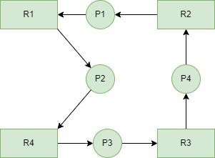
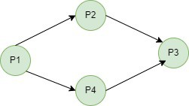
Deadlock Detection-Single Instance
Wait for Graph
Resource Allocation Graph

Slide 35
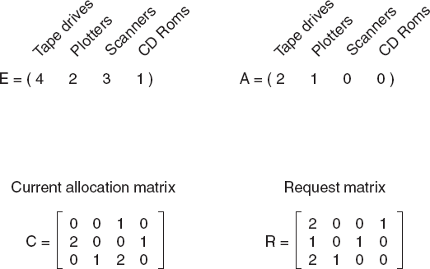
Deadlock Detection: Multiple Resources of Each Type
Three process and four classes for device are there

Slide 36
Deadlock Detection: Multiple Resources of Each Type
We will check the request matrix, process 0 request can not satisfied.
The process 1 request can not be satisfied.
Process 2 request can be satisfied so resources are granted.
Now A=(0 0 0 0)
After completion of process 2
A=(2 2 2 0)
Now we can assign resources to process 1.
After process 1 A=(4 2 2 1)
So there no dead lock.

Slide 37




Deadlock Recovery
Recovery
Recovery through preemption
Recovery through rollback
Recovery through killing processes

Slide 38
Deadlock Recovery
Recovery through preemption
In some cases, it may be possible to temporarily take a resource away from its current owner and give it to another process.
Recovering this way is frequently difficult or impossible.
Choosing the process to suspend depends largely on which
ones have resources that can easily be taken back.
P₁
R₁
R₂
P₂

Slide 39
Deadlock Recovery
Recovery through killing processes
The simplest way to break a deadlock is to kill one or more processes.
Kill all the process involved in deadlock.
Kill process one by one.
After killing each process check for deadlock.
If deadlock recovered then stop killing more process.
Otherwise kill another process.

Slide 40
Deadlock Recovery
Recovery through rollback
Checkpoint a process periodically.
Check pointing a process means that its state is written to a file
so that it can be restarted later.
When deadlock is detected, rollback the preempted process up to the previous safe state before it acquired that resource.

Slide 41
Advantages- Deadlock Detection
Improved System Stability: Detecting and resolving deadlocks can help to improve the stability of the system.
Better Resource Utilization: By detecting and resolving deadlocks, the operating system can ensure that resources are efficiently utilized and that the system remains responsive to user requests.
Better System Design: Deadlock detection and recovery algorithms can provide insight into the behavior of the system and the relationships between processes and resources, helping to inform and improve the design of the system.

Slide 42
Disadvantages- Deadlock Detection
Performance Overhead: The system must regularly check for deadlocks and take appropriate action to resolve them.
Complexity: Deadlock detection and recovery algorithms can be complex to implement, especially if they use advanced techniques such as the Resource Allocation Graph.
Risk of Data Loss: In some cases, recovery algorithms may require rolling back the state of one or more processes, leading to data loss or corruption.

Slide 43
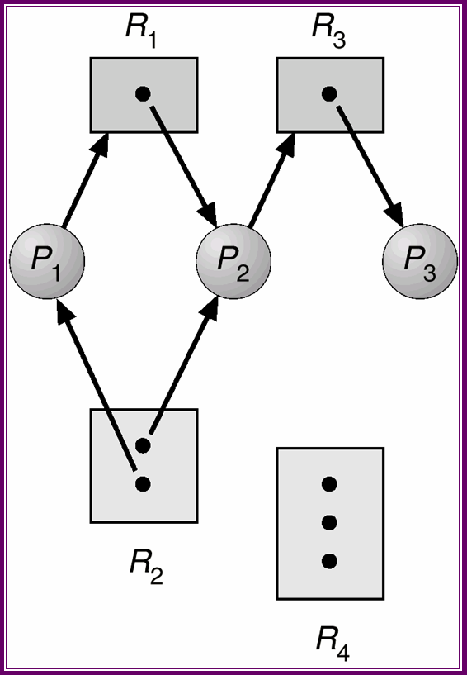
Practice Problem
Detect Deadlock using RAG and draw wait for graph.

Slide 44
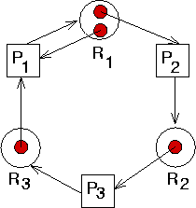
Practice Problem
Detect Deadlock using RAG and draw wait for graph.

Slide 45
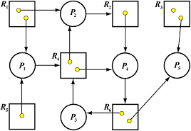
Practice Problem
Detect Deadlock using RAG and draw wait for graph.

Slide 46


